Slide 1
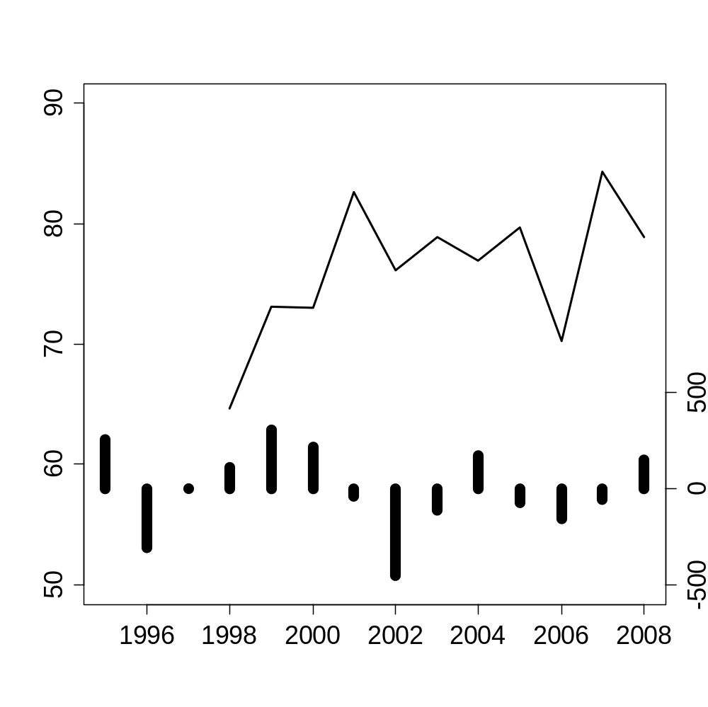
Richness at 100m2 seems to increase slightly and there appears to be a slight lag effect of the rain on richness (maybe 2 years) but this is not clear and will be difficult to statistically pull out with the short series
The centered precip data looks like it is following an el nino cycle, but just my first look at the ENSO index did not suggest a great correlation, 2002 was known as a strong el nino year though
Mean species richness at 100 m²
Annual precipitation deviation (mm)
Year

Slide 2
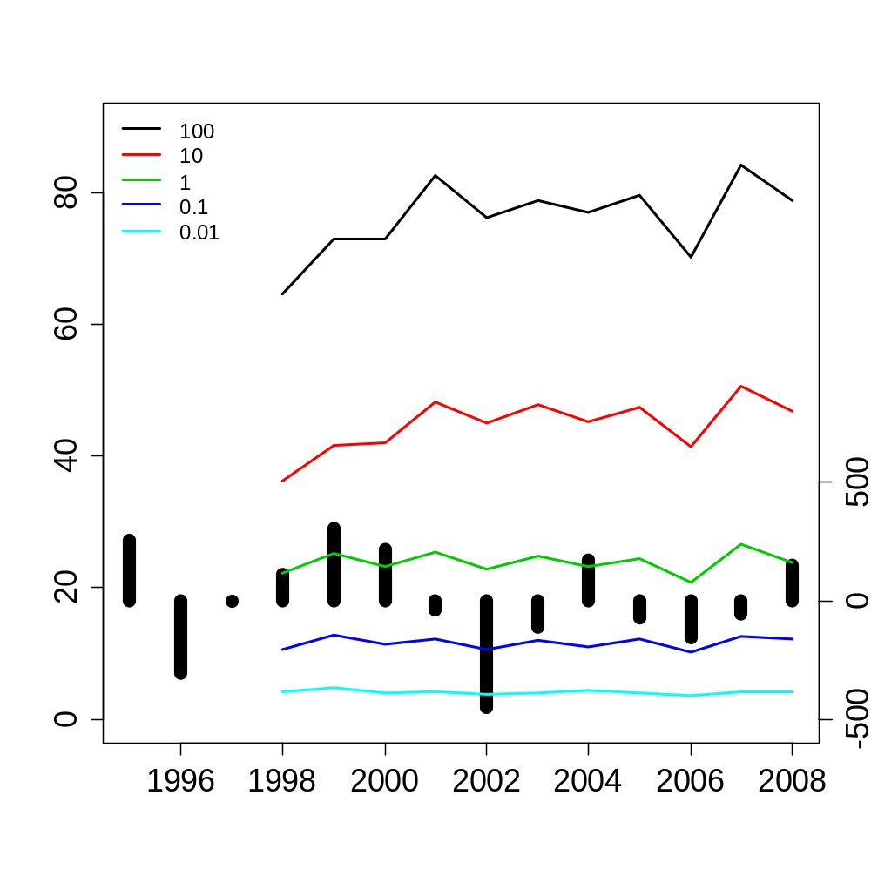
Richness for every spatial scale, its interesting that at 1m2 richness seems to teeter totter
Mean species richness
Annual precipitation deviation (mm)
Year

Slide 3
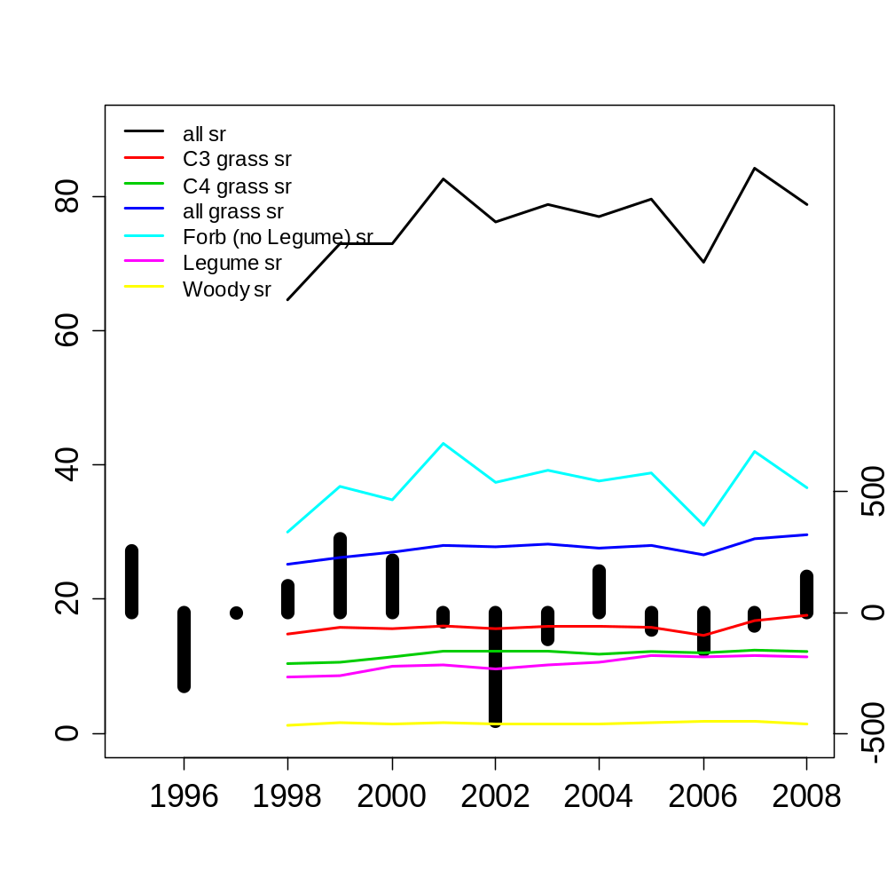
Forbs that are not legumes are definitely the ones driving the variance in richness at the 100 m2 scale
Mean species richness at 100 m²
Annual precipitation deviation (mm)
Year

Slide 4
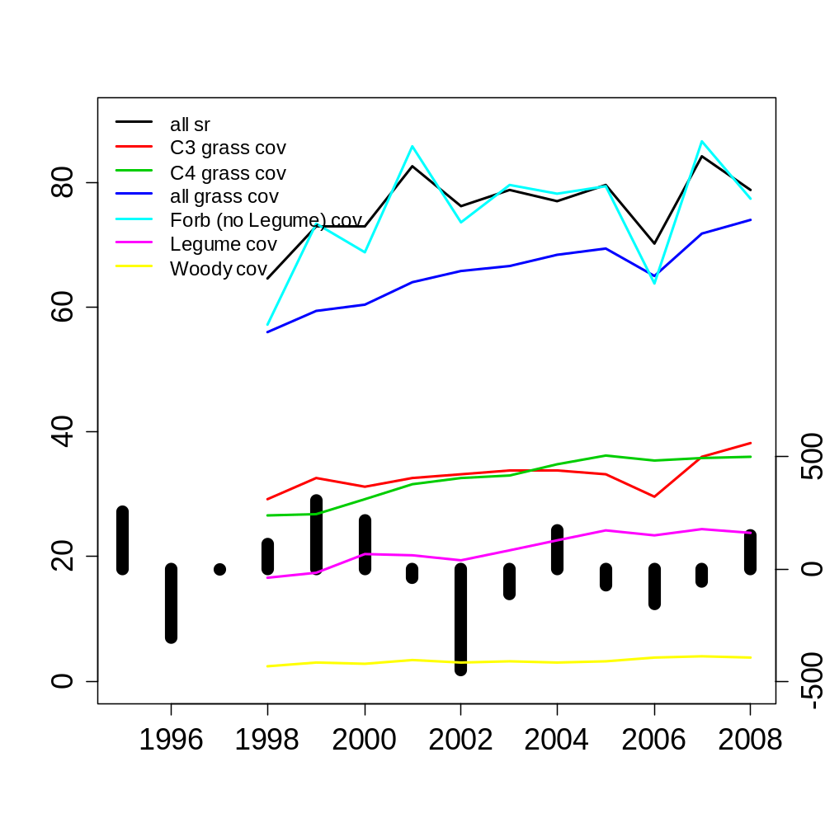
Total cover of c3 and c4 grasses do not seem to inhibit richness at the 100 m2 contrary to other findings, but look how the c3 and c4 cover seem to be mirror images of each other
Are you surprised grass cover is increasing through time, may this be indicative of recovery from over grazing?
Mean species richness & total cover at 100 m²
Annual precipitation deviation (mm)
Year

Slide 5
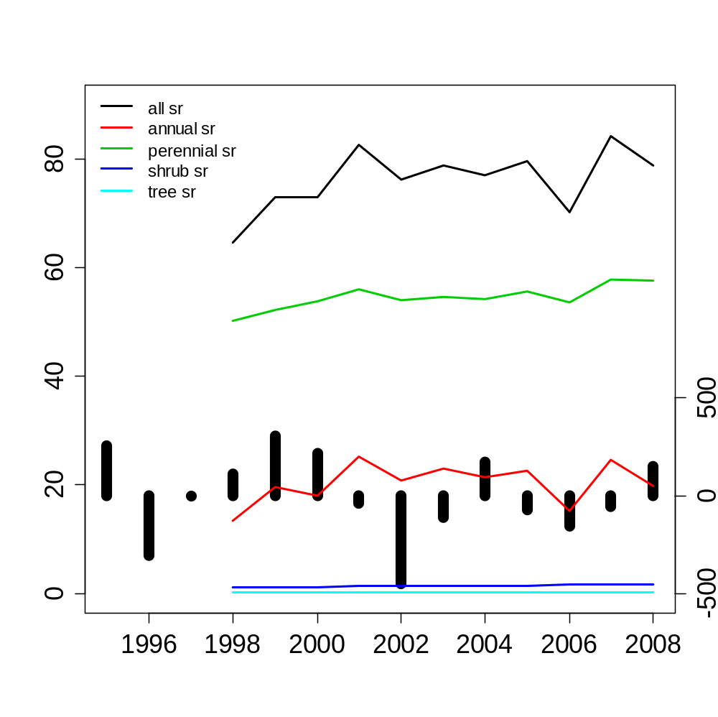
Annual plants are also the ones driving the dynamics of total SR at the 100m2 scale
Mean species richness at 100 m²
Annual precipitation deviation (mm)
Year

Slide 6
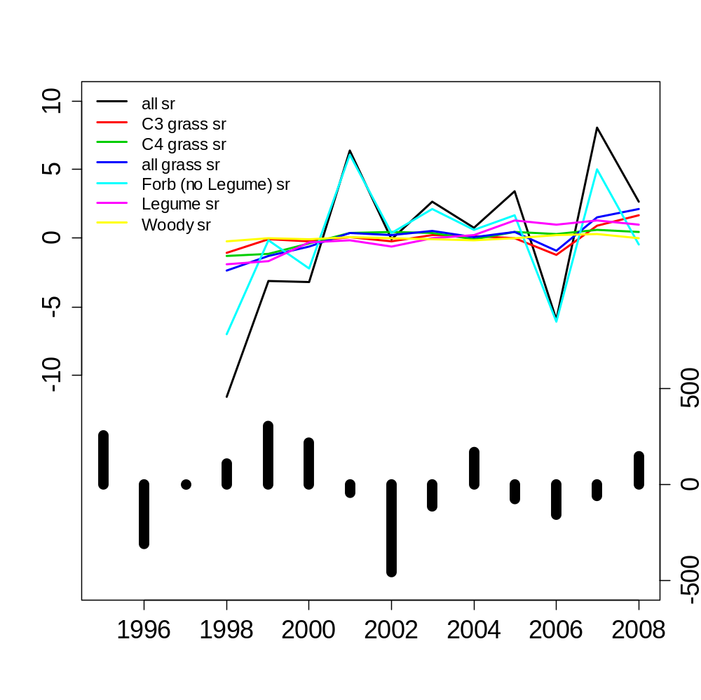
SR centered by plot means
Annual precipitation deviation (mm)
Year

Slide 7
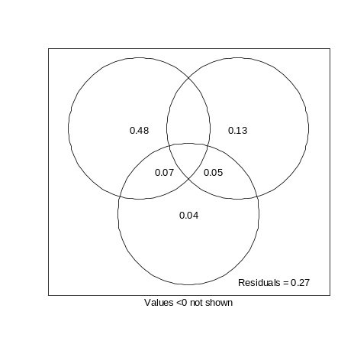
Var Part on richness at 100m2
Pseudo R2 for linear model that considers AR1 within plots
 | R2 | R2adj | pR2
expl var | 0.779 | 0.74 | 0.653
Plot (20) | 0.46 | 0.408 | 0.328
Yr (11) | 0.131 | 0.089 | 0.381
Dist (4) | 0.024 | 0.006 | 0.082
plot&yr | 0.014 | -0.136 | -0.086
plot&dist | 0.104 | -0.001 | -0.025
yr&dist | 0.049 | -0.016 | 0.012
plot&yr&dist | -0.003 | -0.003 | -0.137
b/c we correct for within plot temporal autocorr, the expl power of plot id is diminished rel. to year
R2 adj from vegan, RDA on richness
Estimate Std. Error t value Pr(>|t|)
dist.mYrsOB 1.4675 0.3127 4.693 5.22e-06 ***
dist.mBP5Yrs -2.3475 0.7484 -3.137 0.001986 **
dist.mYrsSLB -1.0571 0.3349 -3.156 0.001865 **
dist.mbison -4.1985 1.9850 -2.115 0.035752 *
Value Std.Error t-value p-value
dist.mYrsOB 1.44133 0.347782 4.144360 0.0001
dist.mBP5Yrs -2.06256 0.793810 -2.598307 0.0101
dist.mYrsSLB -0.98833 0.347543 -2.843772 0.0050
dist.mbison -4.49469 2.143250 -2.097137 0.0373

Slide 8
A.
Y ∩ S | D
8.9
-13.6
40.8
Y | S&D
S | Y&D
0
-0.2
0.1
Y ∩ D | S
S ∩ D | Y
0.6
D | S&Y
S ∩ D ∩ Y
74% of variance explained
n = 220

Slide 9
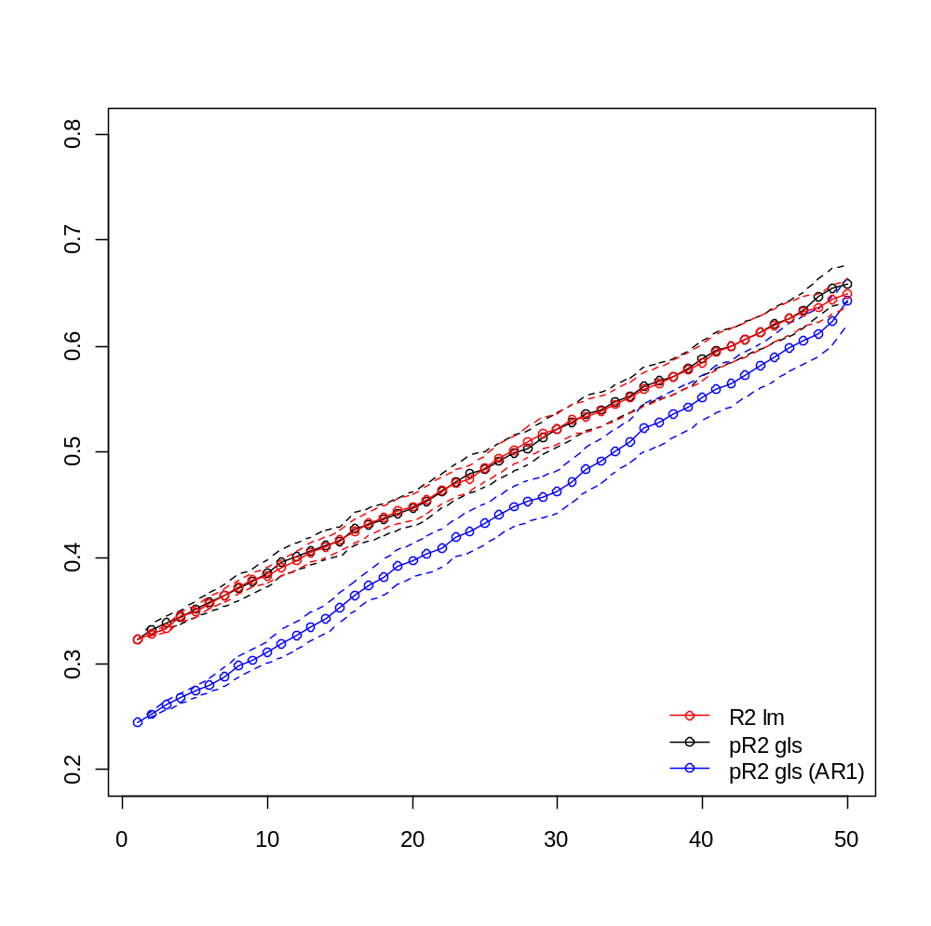
Simulation with pseudo R2
R2 or pseudo R2 measure
# of random uniform variables in model

Slide 10
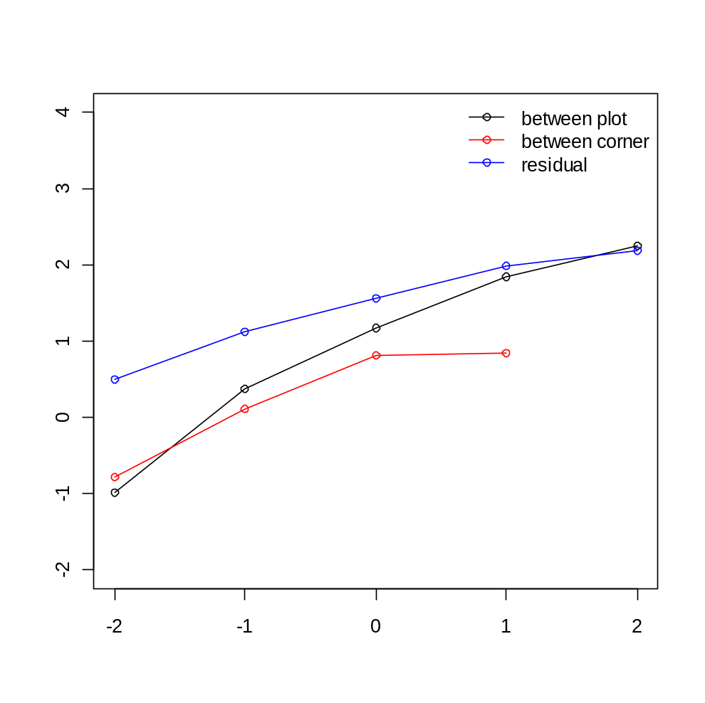
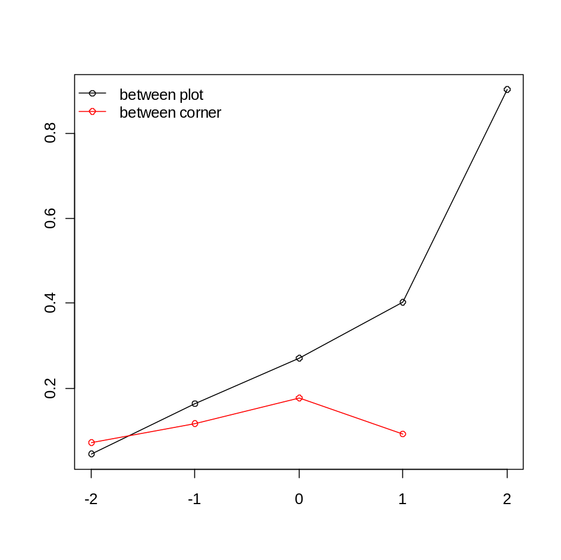
Variance Components Analysis
Log sd of richness expl
proportion of variance explained
Log10 Area (m2)
Log10 Area (m2)

Slide 11
Generalized least squares fit by maximum likelihood
Model: rich ~ -1 + name + yr.f + dist.m
Data: NULL
AIC BIC logLik
1479.970 1602.14 -703.9848
Correlation Structure: AR(1)
Formula: ~yr | name
Parameter estimate(s):
Phi
0.1548309
Coefficients:
Value Std.Error t-value p-value
…
dist.mYrsOB 1.44133 0.347782 4.144360 0.0001
dist.mBP5Yrs -2.06256 0.793810 -2.598307 0.0101
dist.mYrsSLB -0.98833 0.347543 -2.843772 0.0050
dist.mbison -4.49469 2.143250 -2.097137 0.0373
…
Residual standard error: 6.001573
Degrees of freedom: 220 total; 186 residual
ANOVA table, tests are marginal tests
Denom. DF: 186
numDF F-value p-value
name 20 50.97159 <.0001
yr.f 10 10.51390 <.0001
dist.m 4 6.43325 1e-04

Slide 12
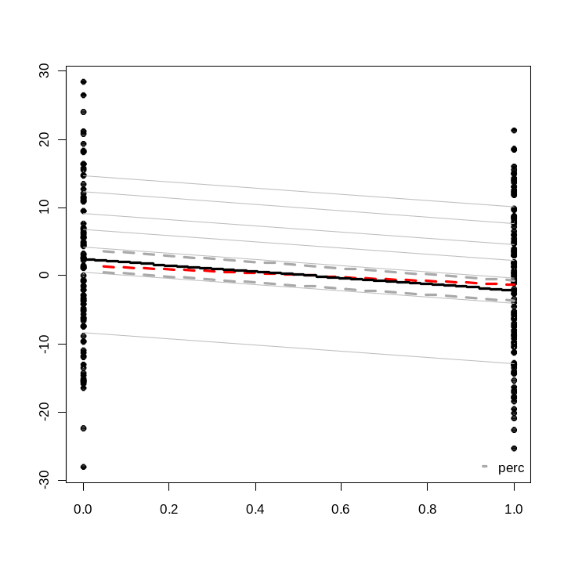
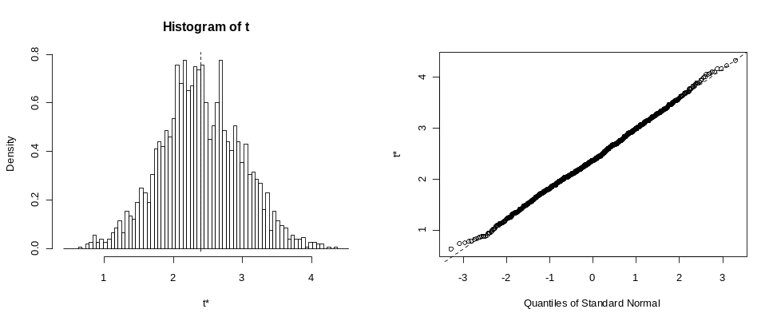
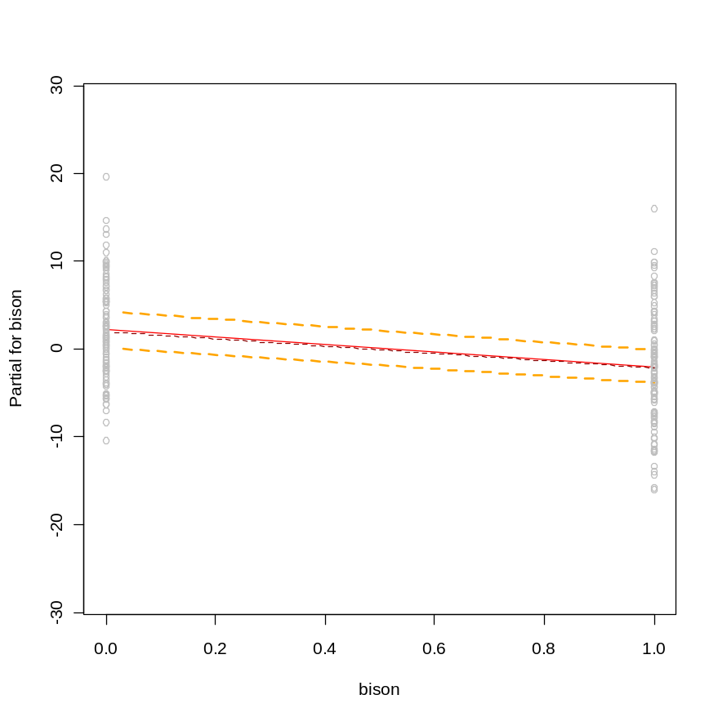
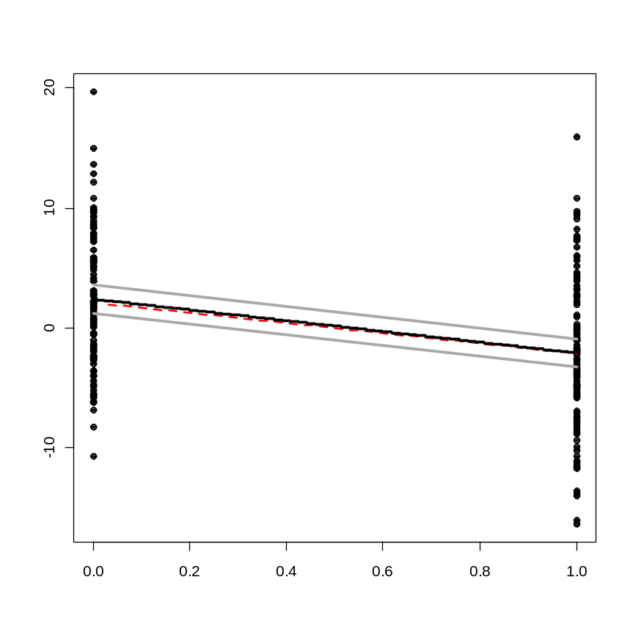
This is the least supported dist relationship, but note that permutations within sites still results in a pvalue of 0.001 or 0.004 (torus rotation) that the slope is significantly different than permuted x model results

Slide 13
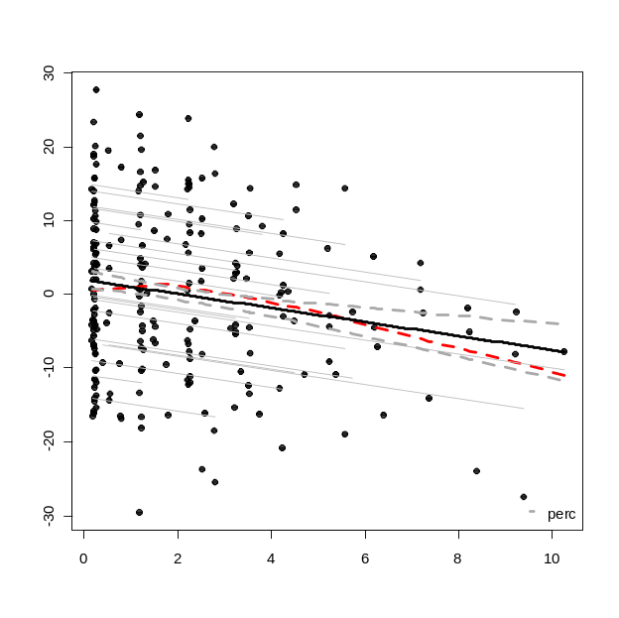
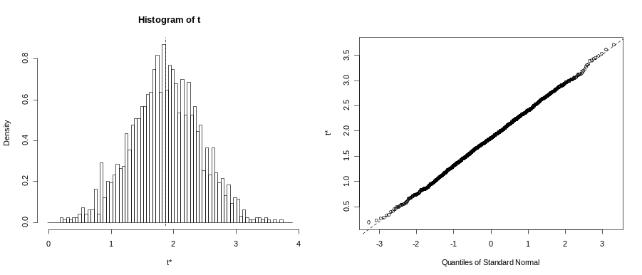
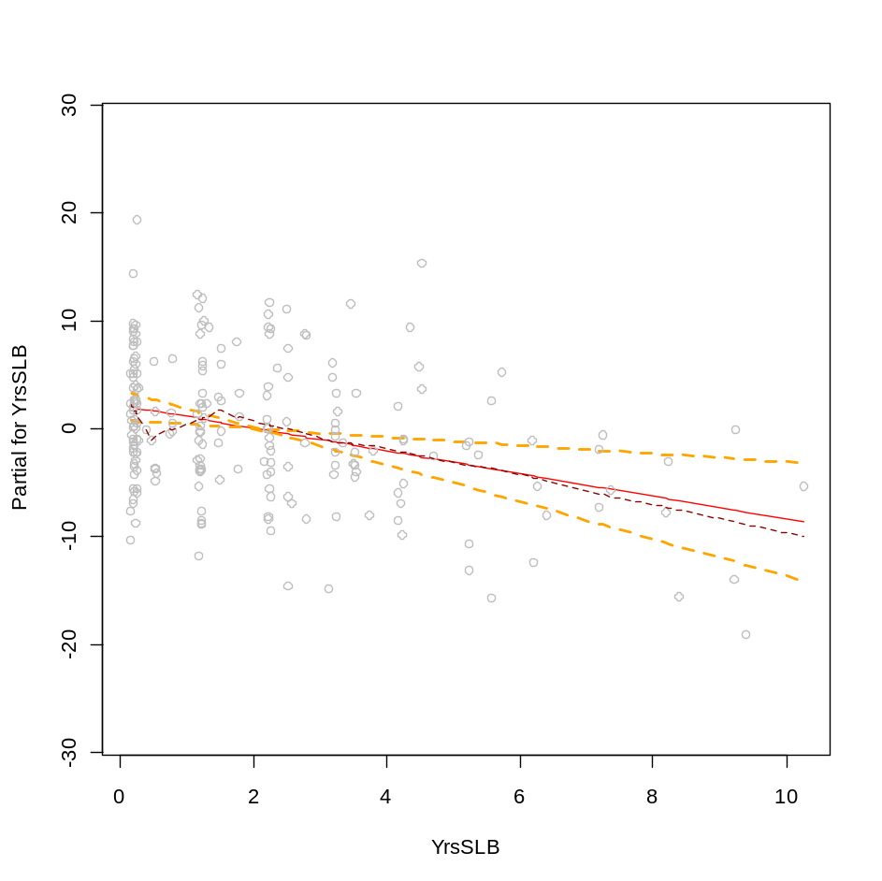
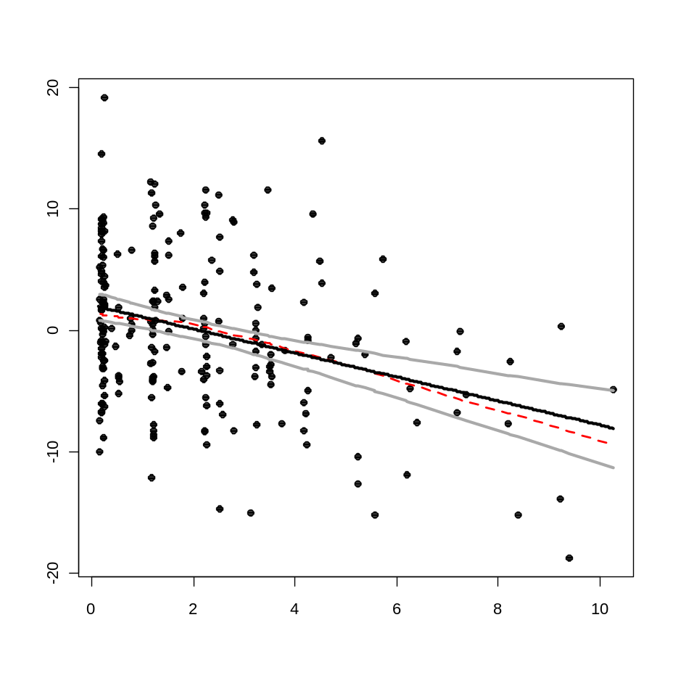

Slide 14
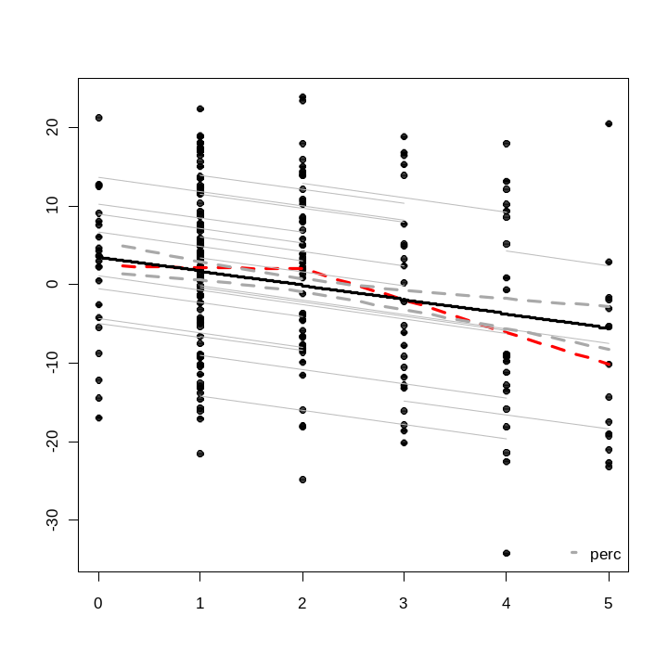
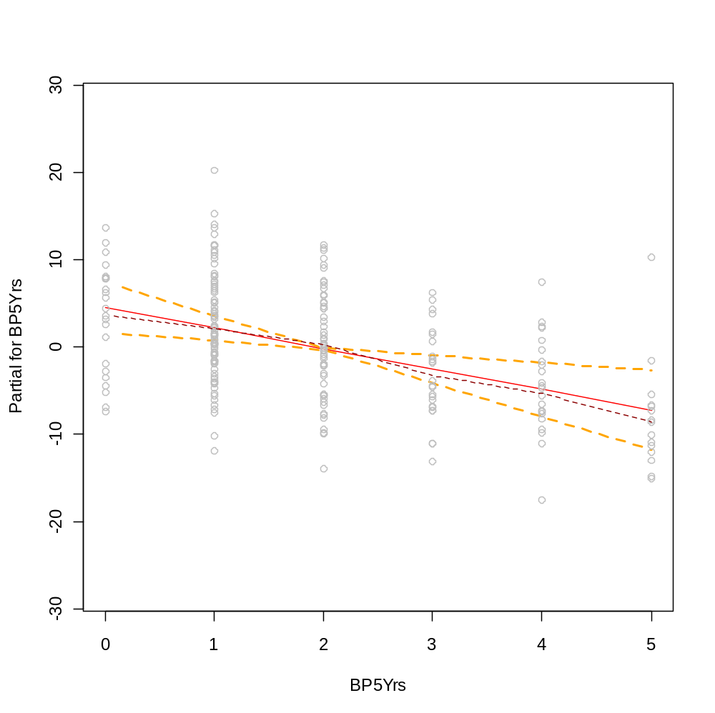
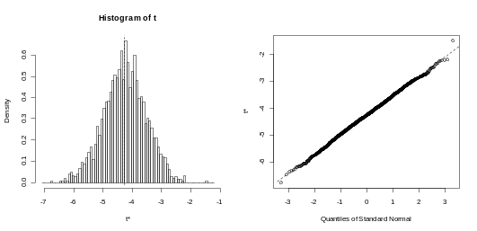
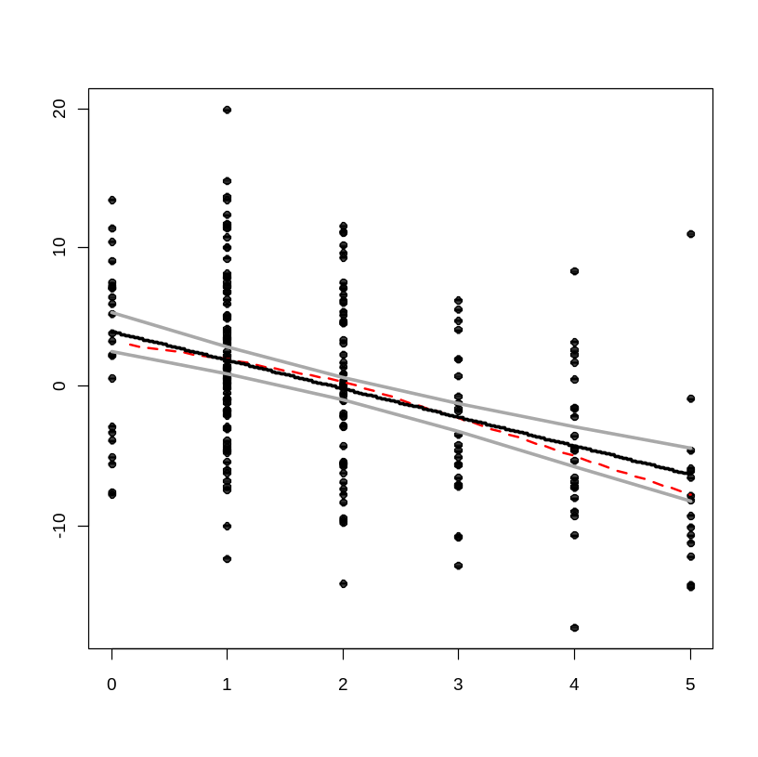

Slide 15
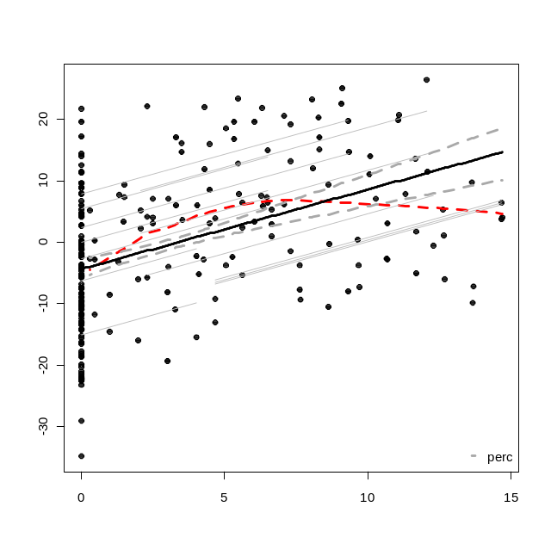
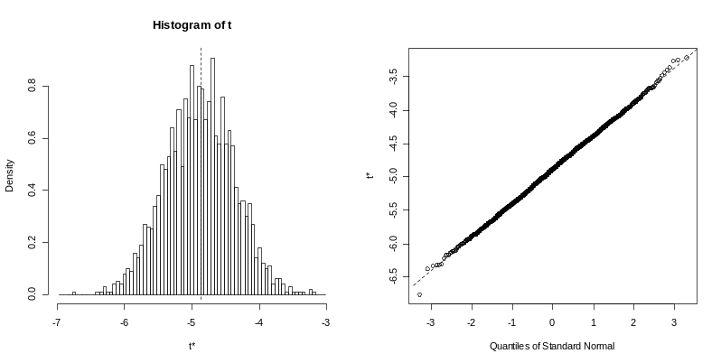
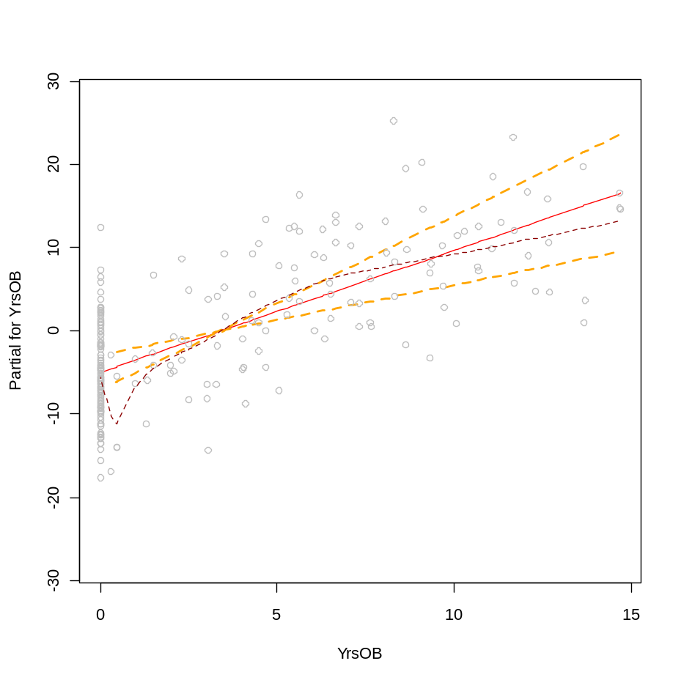
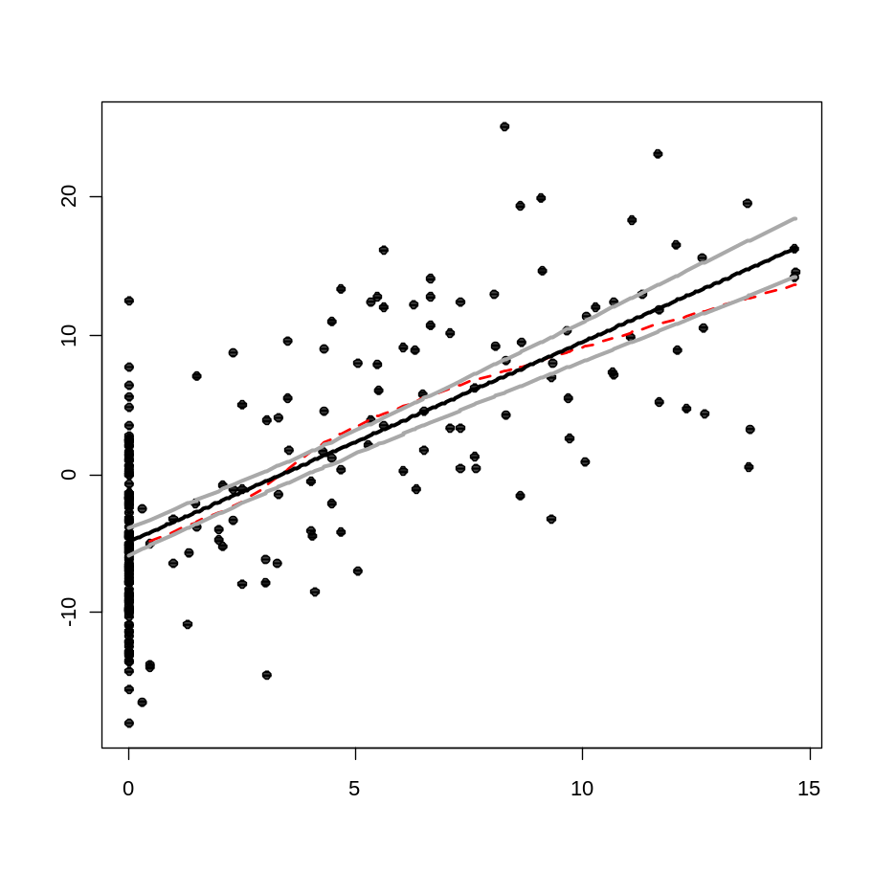
This is statistically better fit by a parabola, but the degree of scatter and potential high leverage of a few points made kept me from introducing a squared term into the model.

Slide 16
Generalized least squares fit by maximum likelihood
Model: resids ~ YrsOB + bison + YrsSLB + BP5Yrs + logCa.avg + northness
Data: NULL
AIC BIC logLik
566.0166 596.5592 -274.0083
Correlation Structure: AR(1)
Formula: ~yr | name
Parameter estimate(s):
Phi
-0.4352804
Coefficients:
Value Std.Error t-value p-value
(Intercept) 5.666311 0.9649477 5.872144 0.0000
YrsOB 0.022202 0.0157758 1.407358 0.1608
bison 0.169601 0.1359101 1.247894 0.2134
YrsSLB -0.149542 0.0302531 -4.943042 0.0000
BP5Yrs -0.194756 0.0520874 -3.739024 0.0002
logCa.avg -1.505124 0.2875772 -5.233809 0.0000
northness 0.100541 0.0597362 1.683091 0.0938
Generalized least squares fit by maximum likelihood
Model: resids ~ YrsOB + bison + YrsSLB + BP5Yrs + rain.tot * temp.avg
Data: NULL
AIC BIC logLik
598.3803 632.3166 -289.1902
Correlation Structure: AR(1)
Formula: ~yr | name
Parameter estimate(s):
Phi
0.03994276
Coefficients:
Value Std.Error t-value p-value
(Intercept) 50.90194 9.387306 5.422422 0.0000
YrsOB 0.09754 0.023439 4.161374 0.0000
bison -0.60623 0.202837 -2.988780 0.0031
YrsSLB -0.08726 0.041771 -2.088897 0.0379
BP5Yrs -0.13847 0.074002 -1.871114 0.0627
rain.tot -0.48831 0.094112 -5.188564 0.0000
temp.avg -3.36185 0.630076 -5.335635 0.0000
rain.tot:temp.avg 0.03244 0.006291 5.155877 0.0000

Slide 17
Linear mixed-effects model fit by maximum likelihood
Data: NULL
AIC BIC logLik
1538.43 1589.334 -754.215
Random effects:
Formula: ~1 | name
(Intercept) Residual
StdDev: 5.192534 0.01942729
Correlation Structure: AR(1)
Formula: ~yr | name
Parameter estimate(s):
Phi
0.2301598
Variance function:
Structure: Power of variance covariate
Formula: ~fitted(.)
Parameter estimates:
power
1.365676
Fixed effects: rich ~ cyr + cyr2 + logCa.avg + YrsOB + bison + YrsSLB + BP5Yrs + rain.tot * temp.avg
Value Std.Error DF t-value p-value
(Intercept) 643.1845 78.73337 191 8.169147 0.0000
cyr 0.6151 0.21897 191 2.809166 0.0055
cyr2 -0.2079 0.07182 191 -2.894697 0.0042
logCa.avg -41.0694 8.28331 18 -4.958093 0.0001
YrsOB 1.4387 0.30364 191 4.738115 0.0000
bison -3.7367 2.04328 191 -1.828801 0.0690
YrsSLB -1.1284 0.37563 191 -3.003960 0.0030
BP5Yrs -2.0855 0.75546 191 -2.760605 0.0063
rain.tot -4.0613 0.73781 191 -5.504592 0.0000
temp.avg -28.4800 4.91873 191 -5.790107 0.0000
rain.tot:temp.avg 0.2739 0.04899 191 5.591655 0.0000
Bonferonni p-value for 10 tests is 0.005,
We don’t care about the intercept test
T-table for Standardized explanatory variables
Value Std.Error DF t-value p-value
(Intercept) 79.78311 1.9745668 191 40.40538 0.0000
syr 1.94966 0.6940367 191 2.80916 0.0055
syr2 -2.08844 0.7214706 191 -2.89470 0.0042
slogca -6.86630 1.3848676 18 -4.95809 0.0001*
syob 6.10048 1.2875331 191 4.73811 0.0000*
bison -3.73674 2.0432768 191 -1.82880 0.0690
syslb -2.41291 0.8032441 191 -3.00396 0.0030
sbp5 -2.88805 1.0461689 191 -2.76060 0.0063
srain -1.46712 0.7227335 191 -2.02995 0.0437
stemp -1.56596 0.4597763 191 -3.40591 0.0008*
srain:stemp 3.59099 0.6422047 191 5.59166 0.0000*

Slide 18

END

Slide 19
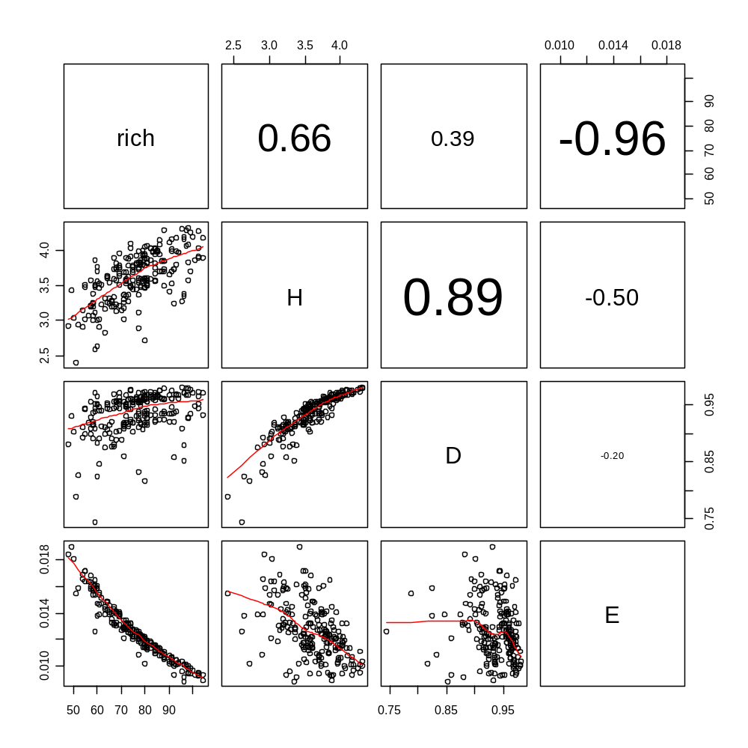
Diversity Indices

Slide 20
Exploratory Linear model
(ignoring psuedoreplication)
First factor out plot and year effects
Note: the year variable (syr) is centered
  mod1<-lm(rich~syr+p1)
  mod2<-update(mod1,.~.+I(syr^2))
  mod3<-update(mod2,.~.+I(syr^3))
  anova(mod1,mod2,mod3)
The cubic term is slightly significant, decide to just keep quadratic term
The following model is found to be most parsimonious and interpretable:
residuals of mod2 ~ grazer+Yrs of bison + # burns in past 5 yrs + Yrs Since last burn
Regression Table
Estimate Std. Error t value Pr(>|t|)
(Intercept) 2.8708 0.9944 2.887 0.004287 **
bison -5.3981 1.6086 -3.356 0.000935 ***
syob 2.1459 0.7775 2.760 0.006280 **
sbp5 -1.5411 0.5890 -2.616 0.009522 **
syslb -2.1174 0.7170 -2.953 0.003495 **
215 is not the correct # of d.f.s given the repeated measures nature of our data
Residual standard error: 7.519 on 215 degrees of freedom
Multiple R-squared: 0.08121, Adjusted R-squared: 0.06412
F-statistic: 4.751 on 4 and 215 DF, p-value: 0.001081
Pretty crappy

Slide 21
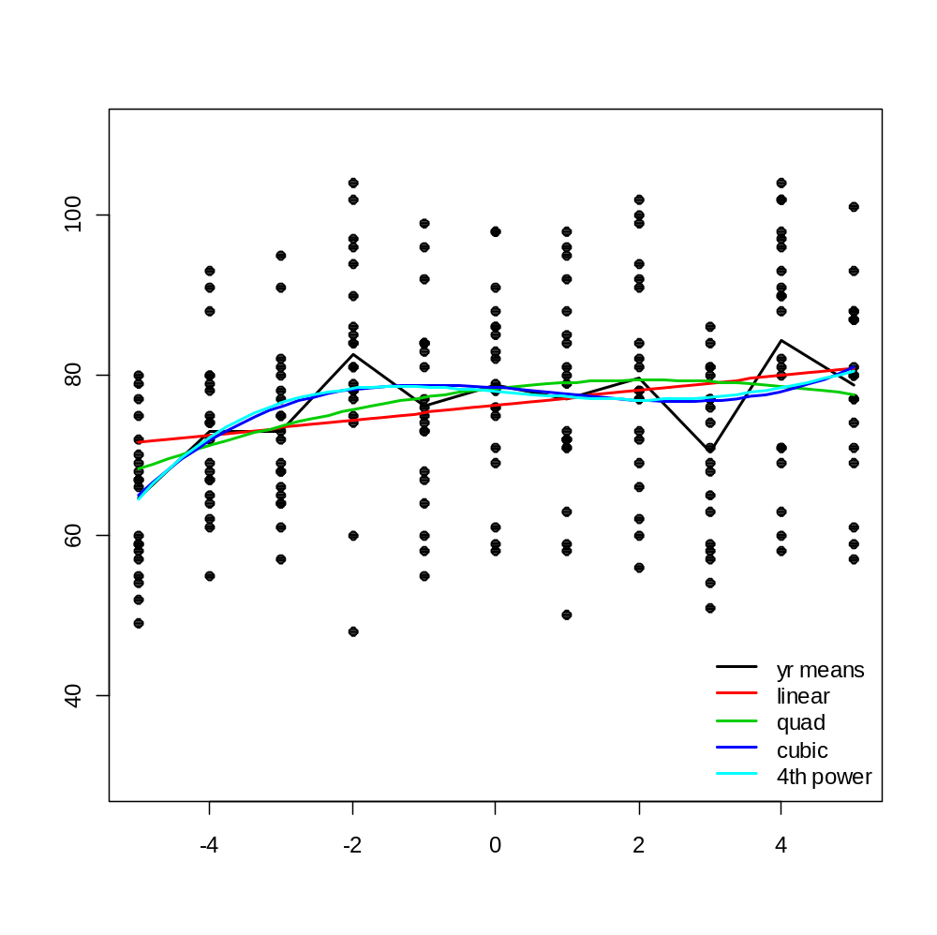
The cubic model was identified as the most parsimonious model for the temporal trend, but the year means model was significantly better
Species richness
Centered Year

Slide 22
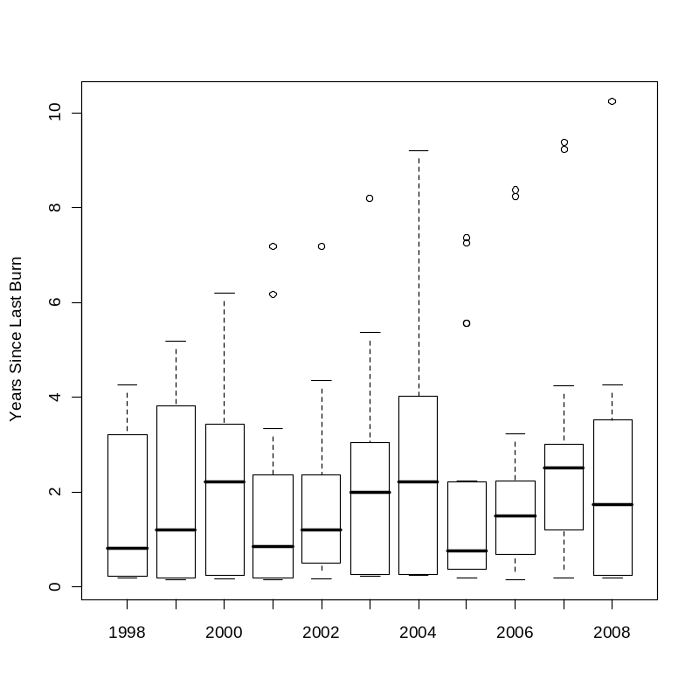
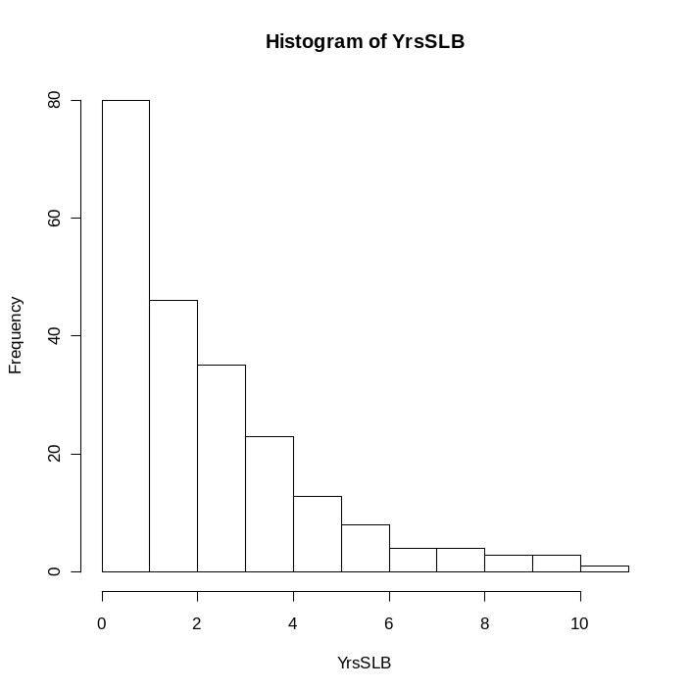
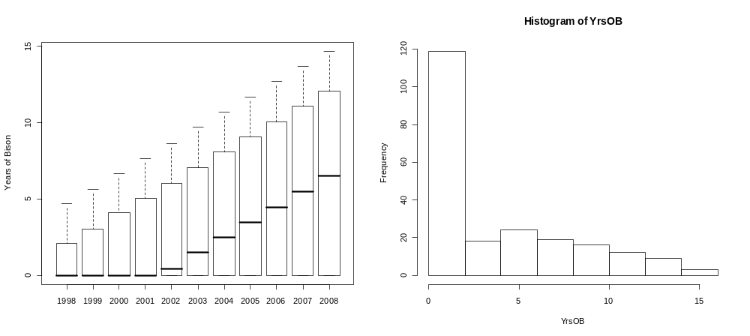

Slide 23
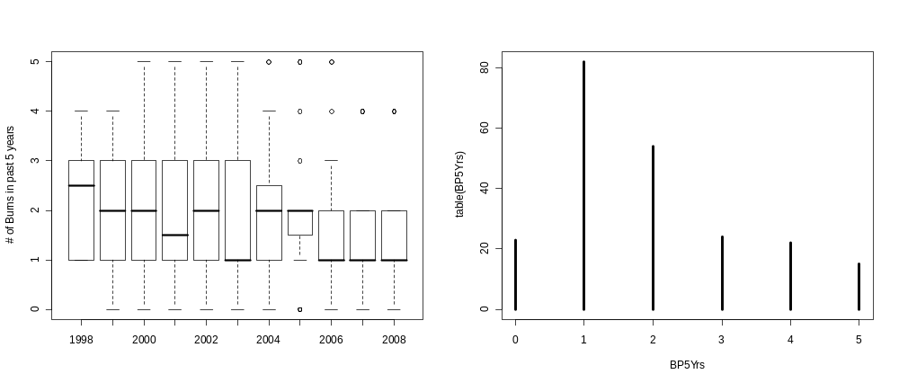
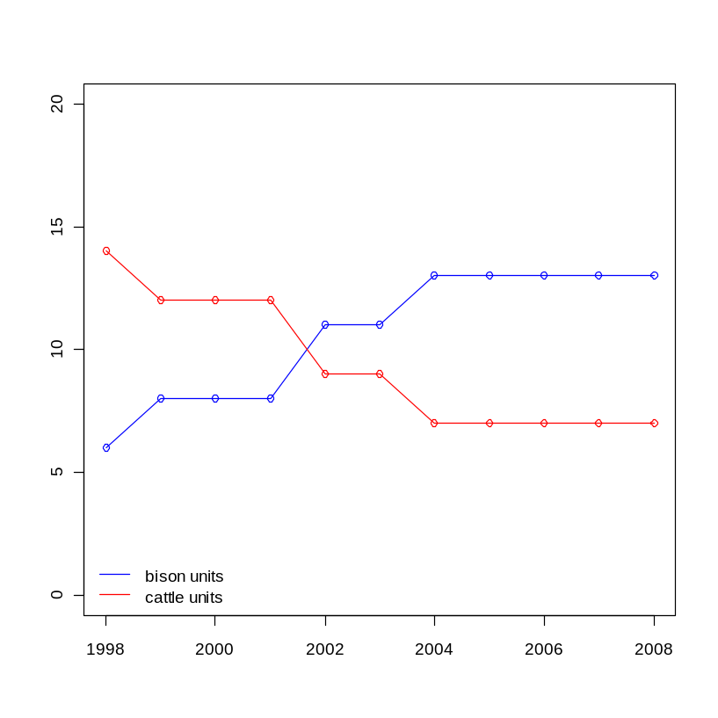
# of Vegmon plots

Slide 24
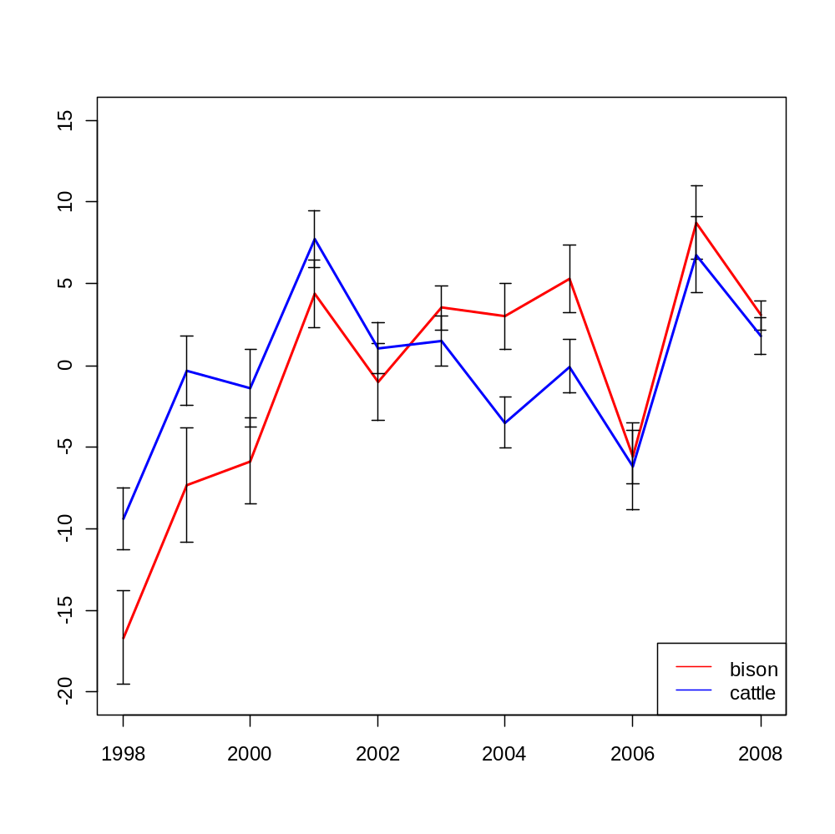
Estimate Std. Error t value Pr(>|t|)
(Intercept) 2.8708 0.9944 2.887 0.004287 **
bison -5.3981 1.6086 -3.356 0.000935 ***
SR centered by plot means
Year

Slide 25
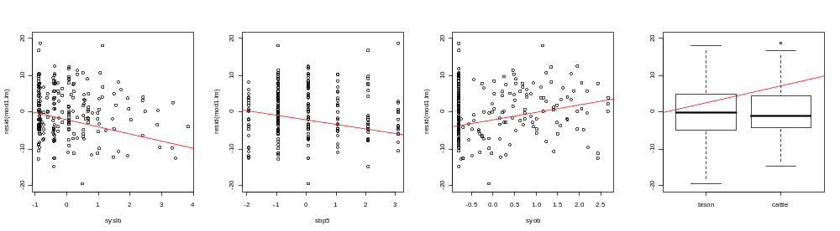
Mod1: rich~plot.id+yr.id
Below the residuals of this model are plotted against the dist variables
Years Since Fire
# Burns in Past 5 years
Years of Bison
Grazer
Although these plots do not look convincing, each variable was found to be significant, the dist vars explain 9% of the variance in the residuals of mod1

Slide 26
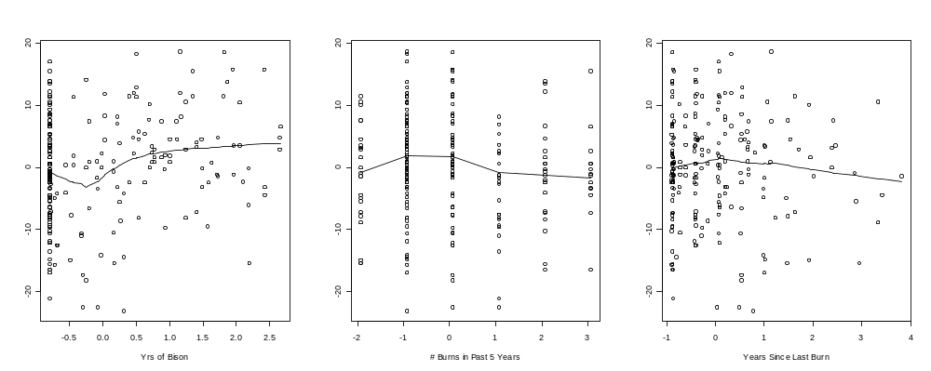
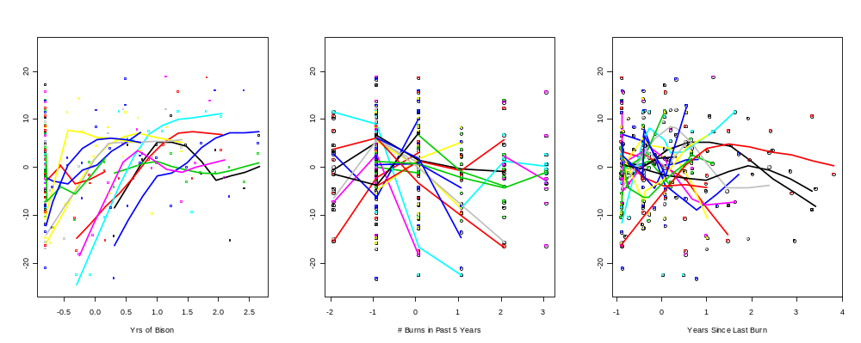
Between Plot patterns
SR centered by plot means
Within Plot effects
Notes:
Estimate Std. Error t value Pr(>|t|)
(Intercept) 2.8708 0.9944 2.887 0.004287 **
bison -5.3981 1.6086 -3.356 0.000935 ***
syob 2.1459 0.7775 2.760 0.006280 **
sbp5 -1.5411 0.5890 -2.616 0.009522 **
syslb -2.1174 0.7170 -2.953 0.003495 **

Slide 27
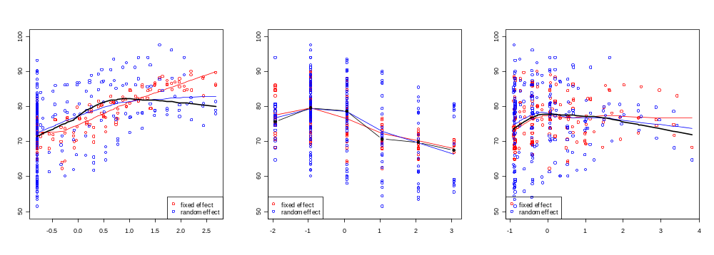
Mixed model fitted and observed richness
Species Richess
Years of Bison
# Burns in Past 5 yrs
Yrs since last burn

Slide 28
Linear mixed-effects model fit by REML
Data: dobject
AIC BIC logLik
1573.773 1607.386 -776.8865
Random effects:
Formula: ~1 | p1
(Intercept) Residual
StdDev: 9.130346 0.03152519
Variance function:
Structure: Power of variance covariate
Formula: ~fitted(.)
Parameter estimates:
power
1.264495
Fixed effects: rich ~ syr + syr2 + syob + grazer + syob + sbp5 + syslb
Value Std.Error DF t-value p-value
(Intercept) 76.00287 2.3449865 194 32.41079 0.0000
syr 0.32932 0.2106197 194 1.56358 0.1195
syr2 -0.27766 0.0551973 194 -5.03029 0.0000
syob 5.47503 1.2807923 194 4.27472 0.0000
grazercattle 6.10237 2.0100388 194 3.03595 0.0027
sbp5 -3.11036 0.7428572 194 -4.18702 0.0000
syslb -2.64988 0.7865268 194 -3.36910 0.0009
Correlation:
(Intr) syr syr2 syob grzrct sbp5
syr -0.074
syr2 -0.203 0.104
syob -0.052 -0.596 -0.086
grazercattle -0.363 0.136 -0.123 0.218
sbp5 0.035 0.100 0.135 0.037 -0.202
syslb -0.017 -0.102 0.070 0.120 -0.030 0.583
Standardized Within-Group Residuals:
Min Q1 Med Q3 Max
-2.41359745 -0.71393938 -0.01023290 0.64902583 2.30823711
Number of Observations: 220
Number of Groups: 20
Approximate 95% confidence intervals
Fixed effects:
lower est. upper
(Intercept) 71.37792855 76.0028692 80.6278099
syr -0.08607824 0.3293201 0.7447185
syr2 -0.38652265 -0.2776587 -0.1687948
syob 2.94896721 5.4750322 8.0010972
grazercattle 2.13803808 6.1023724 10.0667067
sbp5 -4.57547400 -3.1103608 -1.6452477
syslb -4.20112605 -2.6498848 -1.0986436
attr(,"label")
[1] "Fixed effects:"
Random Effects:
Level: p1
lower est. upper
sd((Intercept)) 6.498586 9.130346 12.8279
Variance function:
lower est. upper
power 0.530066 1.264495 1.998925
attr(,"label")
[1] "Variance function:"
Within-group standard error:
lower est. upper
0.001314796 0.031525189 0.755887361

Slide 29
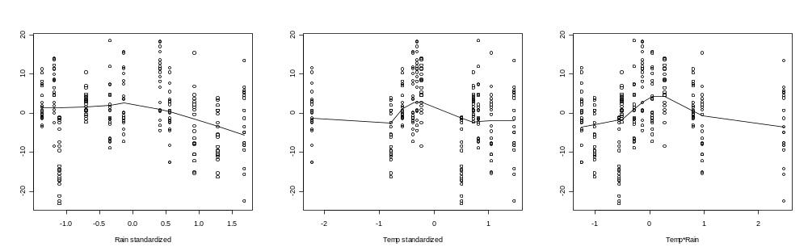
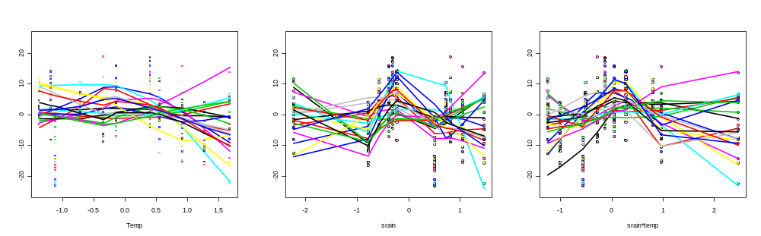
Between Plot patterns
SR centered by plot means
Within Plot effects

Slide 30
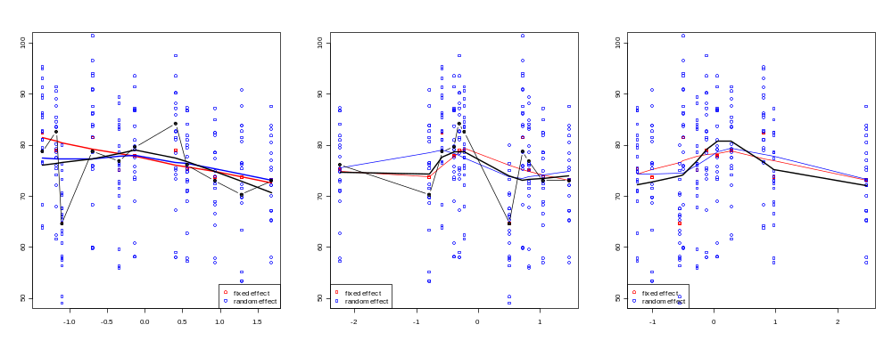
Mixed model fitted and observed richness

Slide 31
Linear mixed-effects model fit by REML
Data: climgrp
AIC BIC logLik
1560.249 1597.224 -769.1247
Random effects:
Formula: ~syr | p1
Structure: Diagonal
(Intercept) syr Residual
StdDev: 9.427788 1.136930 0.01333510
Variance function:
Structure: Power of variance covariate
Formula: ~fitted(.)
Parameter estimates:
power
1.430094
Fixed effects: rich ~ syr + syr2 + syr3 + srain * stemp
Value Std.Error DF t-value p-value
(Intercept) 76.76430 2.2416650 194 34.24432 0.0000
syr -0.02142 0.4658798 194 -0.04598 0.9634
syr2 -0.10081 0.0586789 194 -1.71792 0.0874
syr3 0.07128 0.0186006 194 3.83212 0.0002
srain -1.55049 0.6963887 194 -2.22647 0.0271
stemp -1.65933 0.4491481 194 -3.69440 0.0003
srain:stemp 3.08628 0.7048169 194 4.37884 0.0000
Correlation:
(Intr) syr syr2 syr3 srain stemp
syr -0.020
syr2 -0.275 0.049
syr3 0.017 -0.774 0.004
srain 0.166 -0.133 -0.596 0.148
stemp 0.014 -0.105 -0.067 0.058 0.199
srain:stemp -0.118 0.367 0.412 -0.344 -0.702 -0.376
Standardized Within-Group Residuals:
Min Q1 Med Q3 Max
-2.813731019 -0.622997127 0.005382754 0.653559324 2.843193632
Number of Observations: 220
Number of Groups: 20
Approximate 95% confidence intervals
Fixed effects:
lower est. upper
(Intercept) 72.34313707 76.76430020 81.18546333
syr -0.94026136 -0.02142168 0.89741801
syr2 -0.21653622 -0.10080577 0.01492468
syr3 0.03459431 0.07127966 0.10796501
srain -2.92395510 -1.55049032 -0.17702554
stemp -2.54517328 -1.65933312 -0.77349296
srain:stemp 1.69619085 3.08627842 4.47636599
attr(,"label")
[1] "Fixed effects:"
Random Effects:
Level: p1
lower est. upper
sd((Intercept)) 6.7752901 9.427788 13.118727
sd(syr) 0.7521118 1.136930 1.718642
Variance function:
lower est. upper
power 0.6865616 1.430094 2.173626
attr(,"label")
[1] "Variance function:"
Within-group standard error:
lower est. upper
0.000532404 0.013335097 0.334003566

Slide 32
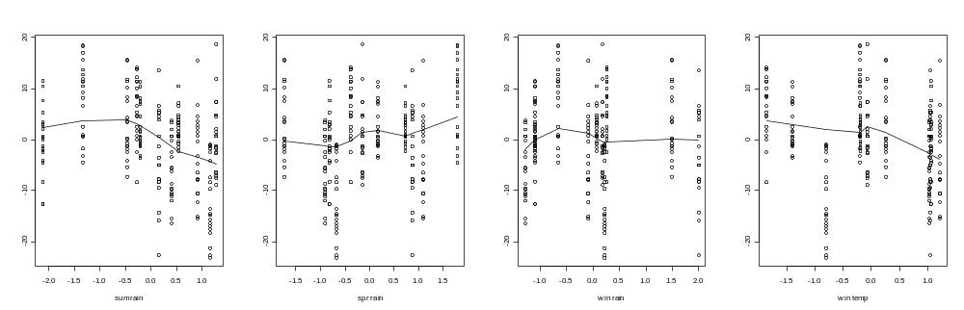
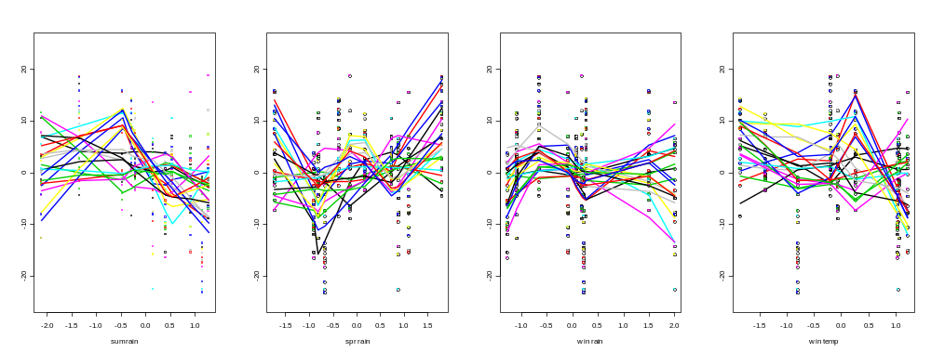

Slide 33
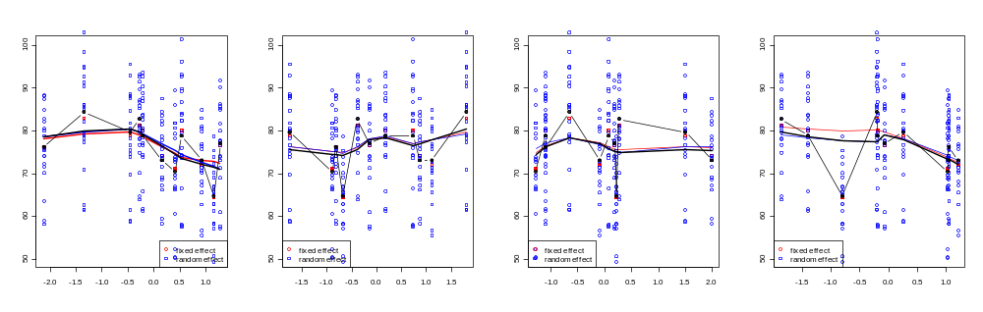

Slide 34
Mixed-effects Model
attempts to consider the pseudoreplication without using up all the d.f.s (e.g. a separate model for every plot) and it predicts the within plot random effect and residual variance which are necessary to gauge the relevance of our inferences for the population of all plots rather than the sample of 20 plots we studied

Slide 35
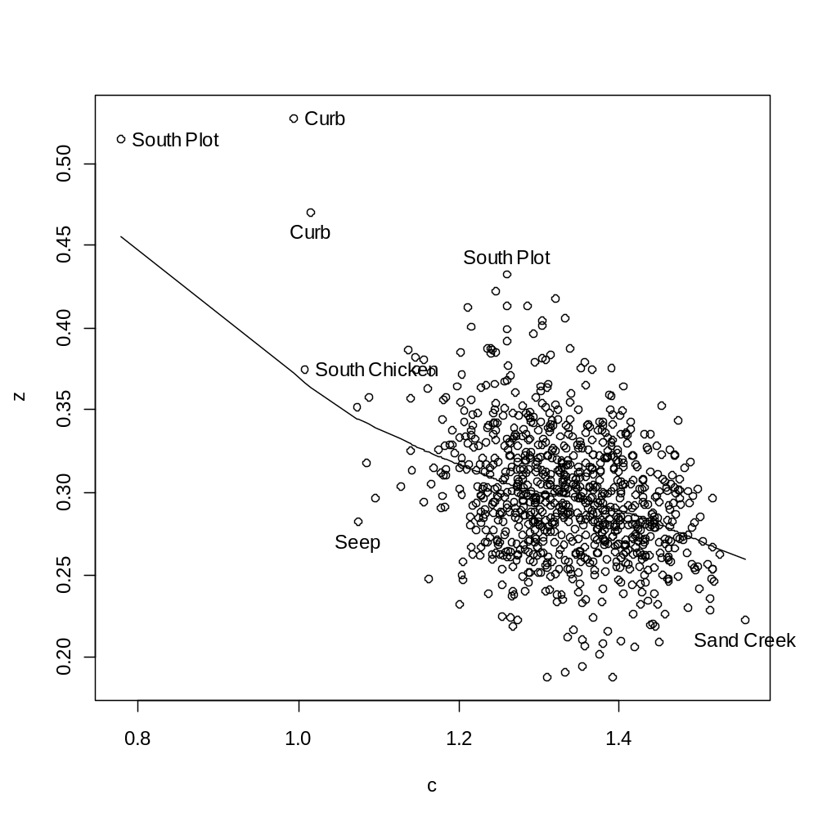
Z & C

Slide 36
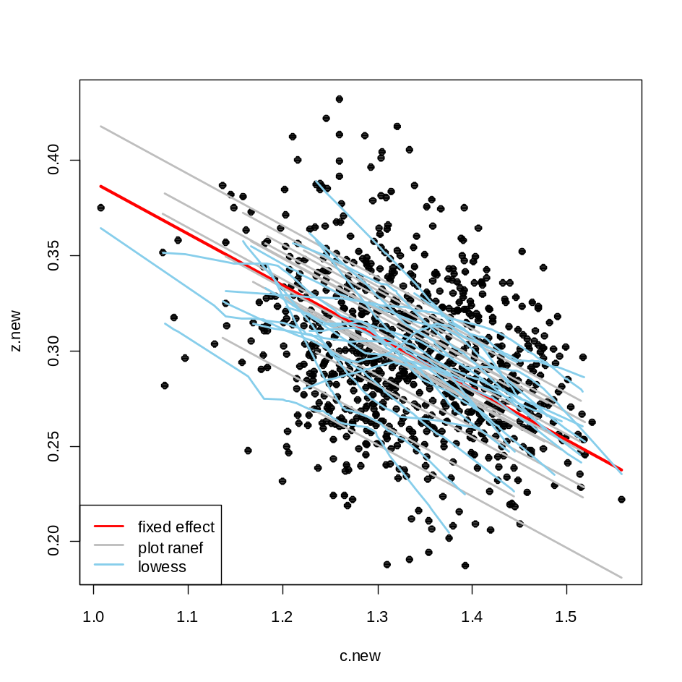
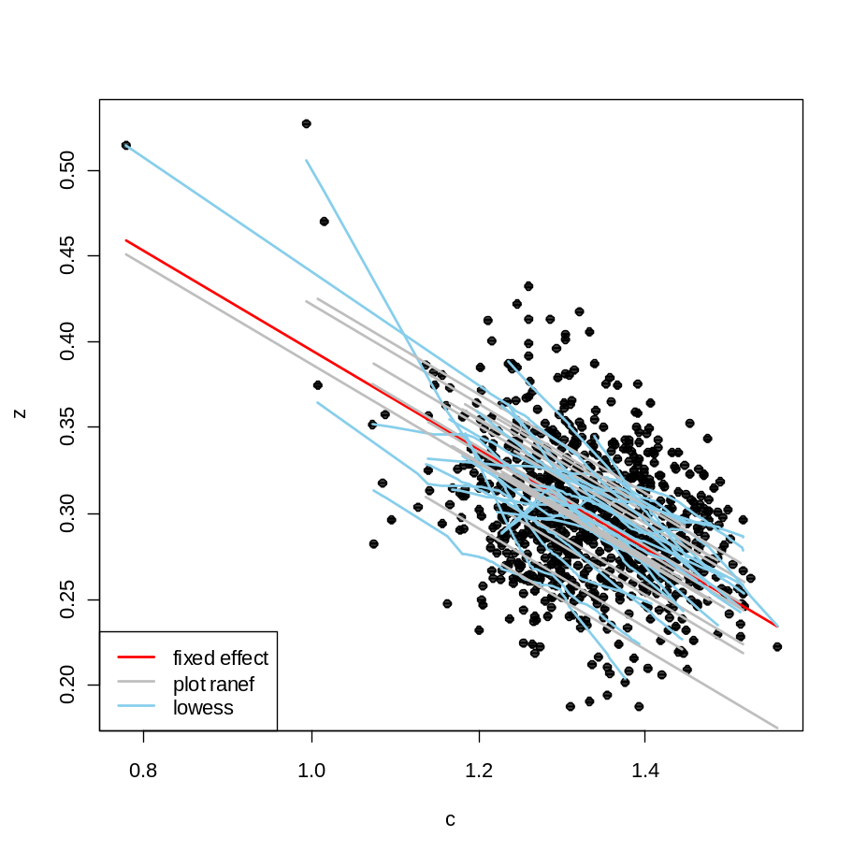

Slide 37
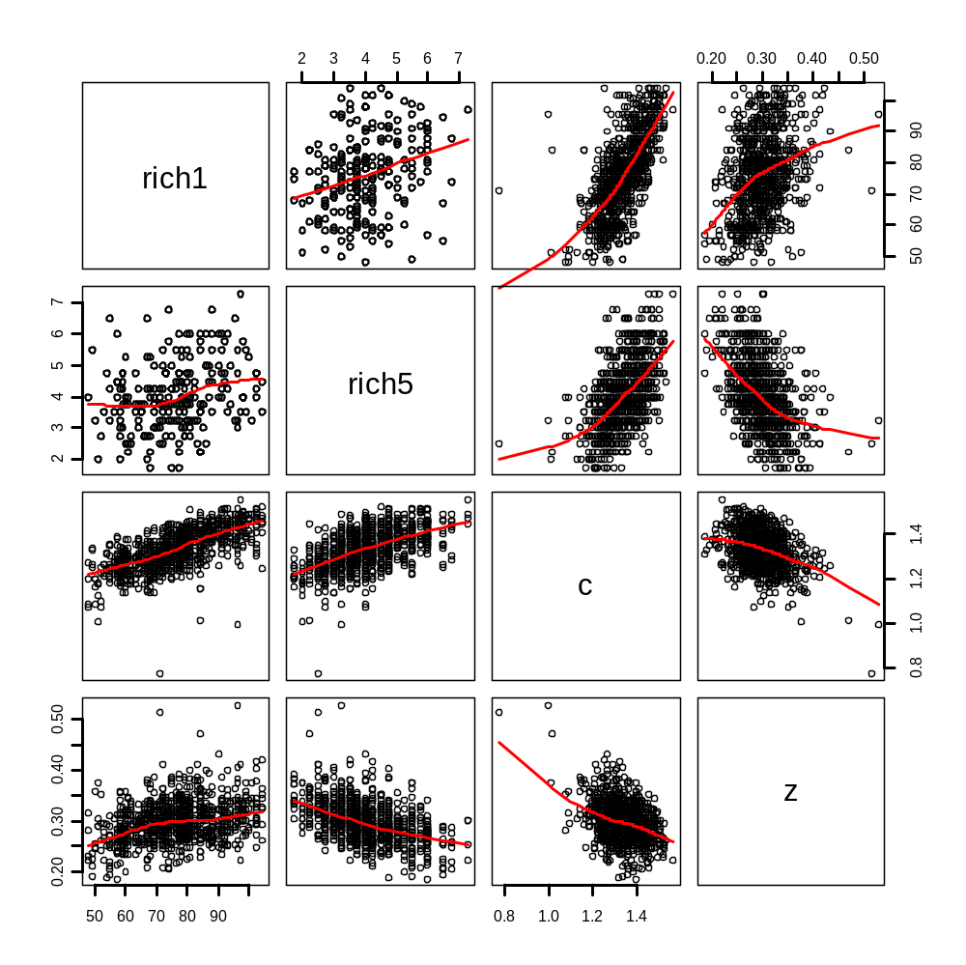

Slide 38
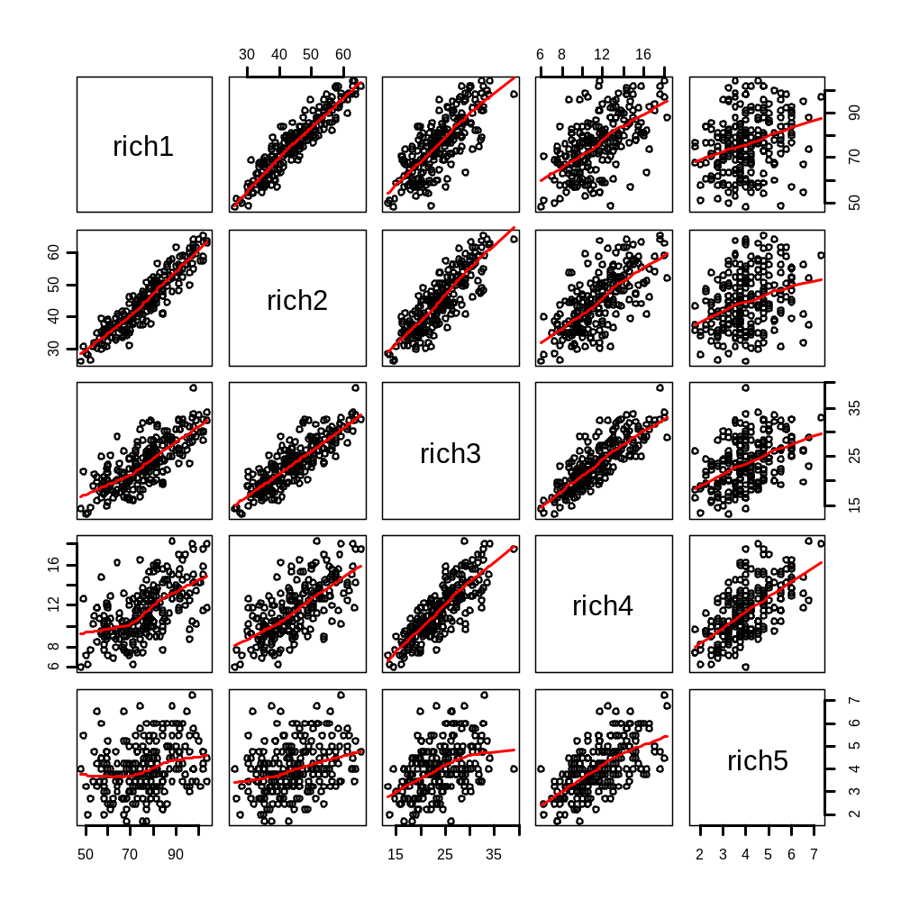

Slide 39
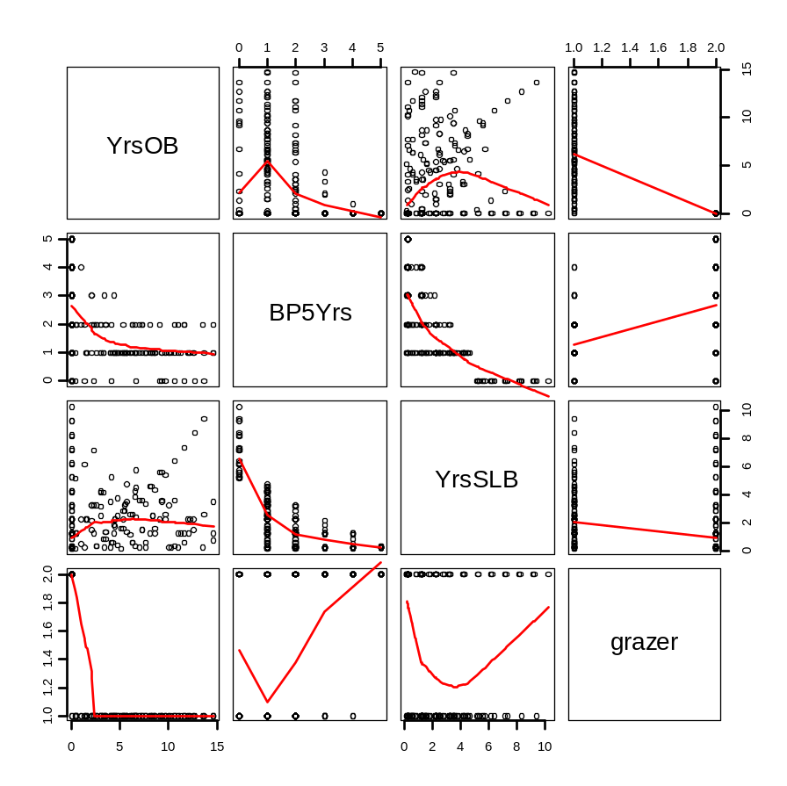


Slide 40



Slide 41

Basic - acidic
Bison mang – Cattle mang
Sum wet/dorm warm – spr wet/grow warm

Slide 42


Partial coef plots for OLS model
Partial coef plots for LME model

Slide 43

Basic - acidic
Bison mang – Cattle mang
Sum wet/dorm warm – spr wet/grow warm

